Slide 1

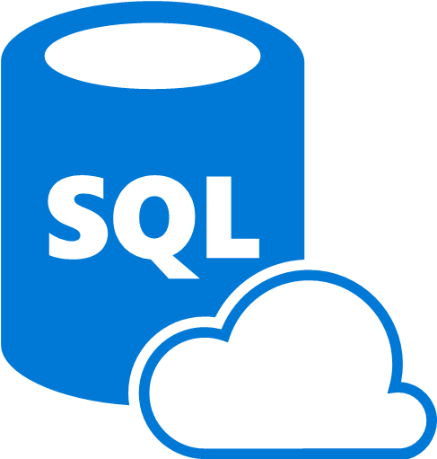

Azure DevOps for CI/CD pipelines with Azure SQL
Carlos López
Cloud Data Engineer
Microsoft MVP Data Platform

Slide 2

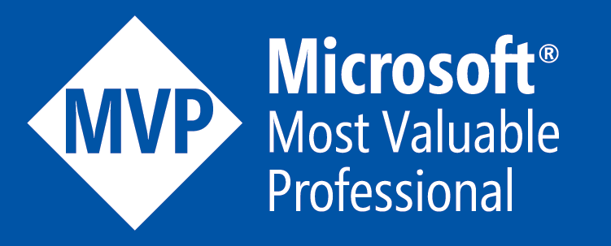



Carlos López
Cloud Data Engineer Microsoft MVP Data Platform
Community Work
Blogger, Speaker, Local Community Leader
carlos-lopez-taks
@CarlosLopezDBA
carlosarturo.lopeztaks
https://www.muppity.net

Slide 3


Agenda
DevOps Perspective
Plan - Develop - Deliver - Operate
Develop phase
Deliver phase
Demo

Slide 4

DevOps cycle for data

Slide 5
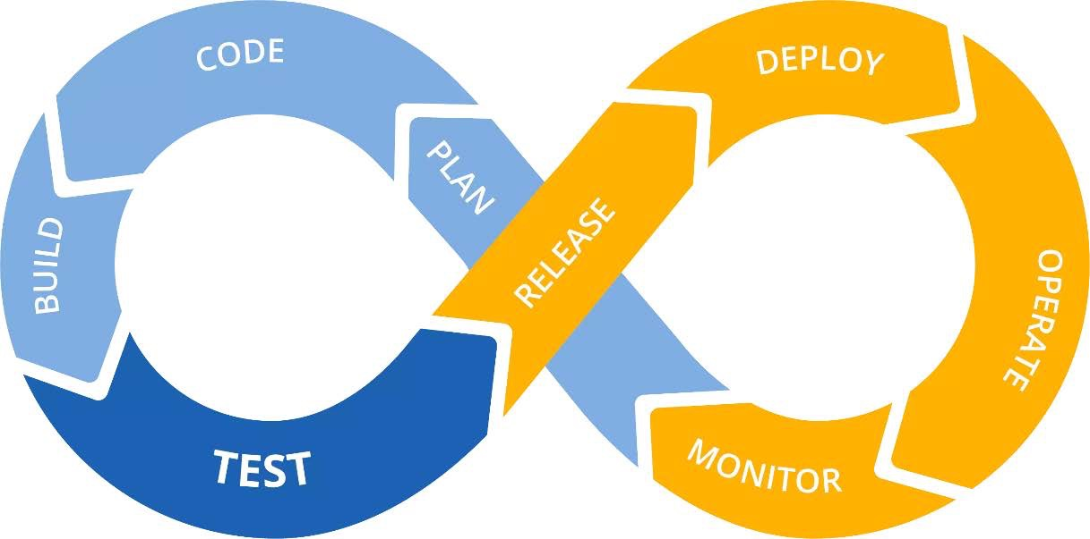
The Classical Loop
Notes:
When we see the classical loop for DevOps Cycle we think in CI/CD process right away as this is something we already have.
We take for granted the cultural impact required in the company
US - Categorization - Scrum poker estimation
-Story points - FIbonnacci
Pros / Cons
sprint planning, daily standup, sprint review, sprint retrospective and product backlog grooming
Backlog
Why is it important to mention it here? Because Azure DevOps has all the inherit process for using the cycle.

Slide 6
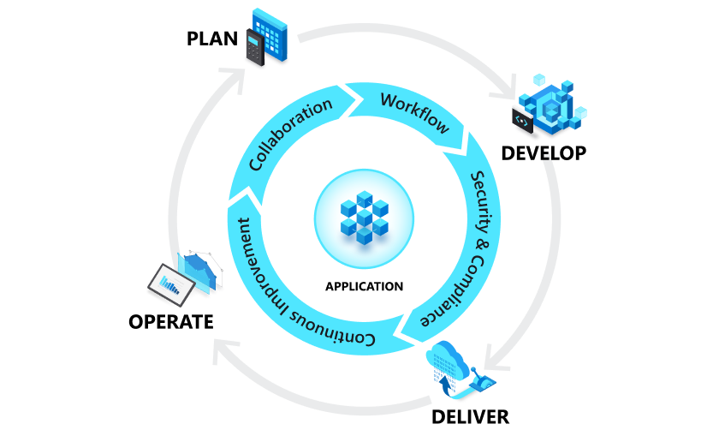
The Azure DevOps cycle
Notes:
Azure DevOps provides a wide variety of services for DevOps teams so that they can plan, work,
collaborate on code development, and build and deploy software and services.
Most DevOps teams rely on several tools and build custom toolchains for each phase in the application life cycle.
When we look at the DevOps Clasical diagram we imagine a
Now we are analyzing the DevOps followed by the Microsft DevOps product,
In which we will focus on Develop en and Deliver Phases
In the following sections, we'll explain these phases and the corresponding Microsoft tooling and products in more detail.

Slide 7
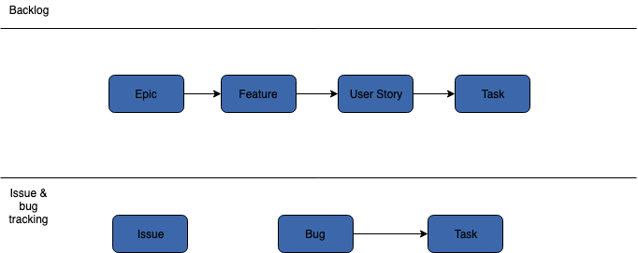
From Epics to User Stories
Notes:
We’ve seen this structure based on SCRUM, in Azure DevOps the implementation of the process comes starting from backlog to
Azure Dev Ops allows us to manage the US to manage the tasks
Assign the workflow, managing the Backlog
US - Categorization - Scrum poker estimation
-Story points - FIbonnacci
Pros / Cons

Slide 8
Configuring your Azure DevOps

Slide 9
The Agents in the Pipelines
Microsoft-hosted agents
Self-hosted agents
Notes:
To build and deploy your code using Azure Pipelines, you need at least one agent. An agent is a service that runs the jobs defined in your pipeline. The execution of these jobs can occur directly on the agent's host machine or in containers.

Slide 10
Some Specs for Self-Hosted
Image | Classic Editor Agent Specification | YAML VM Image Label
Windows Server 2022 with Visual Studio 2022 | windows-2022 | windows-2022
Windows Server 2019 with Visual Studio 2019 | windows-2019 | windows-latest OR windows-2019
Windows Server 2016 with Visual Studio 2017 | vs2017-win2016 | vs2017-win2016
Ubuntu 20.04 | ubuntu-20.04 | ubuntu-latest OR ubuntu-20.04
Ubuntu 18.04 | ubuntu-18.04 | ubuntu-18.04
macOS 11 Big Sur | macOS-11 | macOS-11
macOS X Mojave 10.14 | macOS-10.14 | macOS-10.14
macOS X Catalina 10.15 | macOS-10.15 | macOS-latest OR macOS-10.15

Slide 11
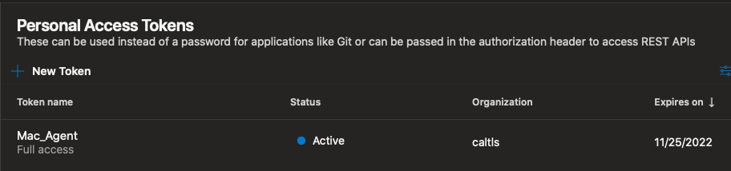
Self-Hosted Agents

Slide 12
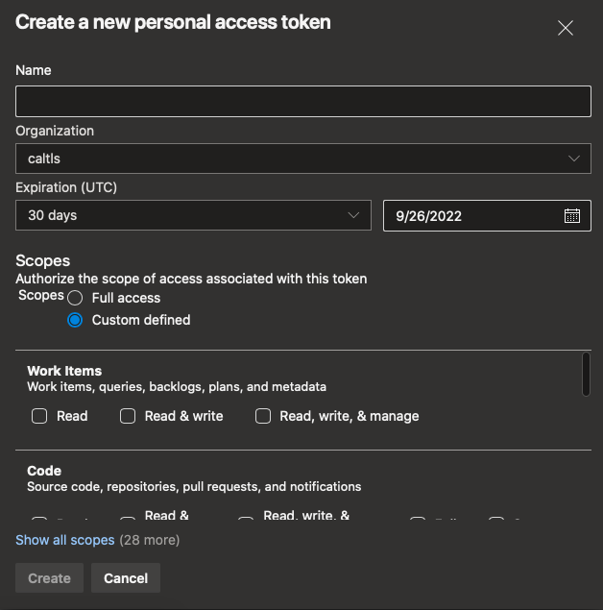
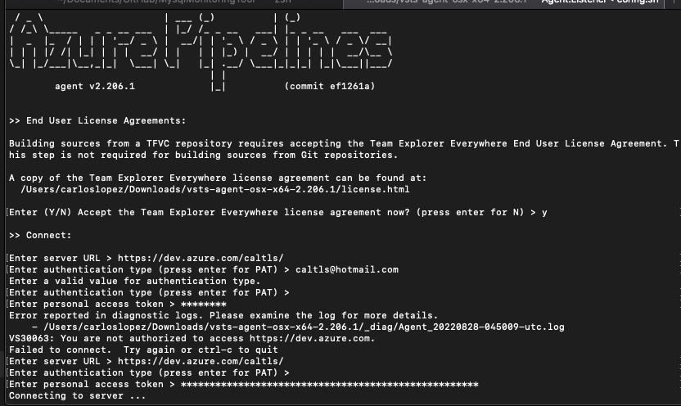
Self-Hosted Agents

Slide 13
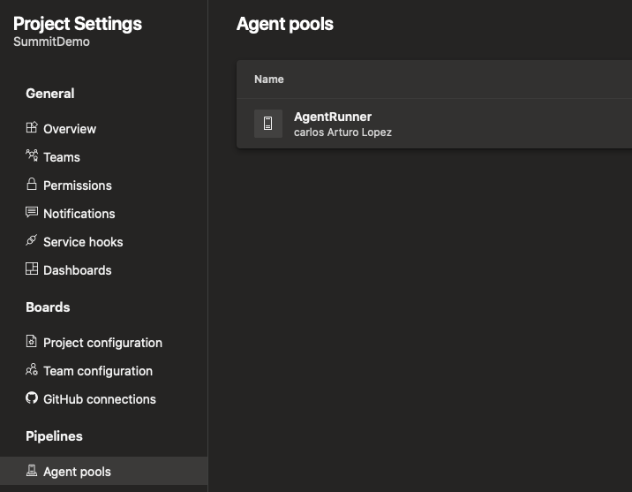
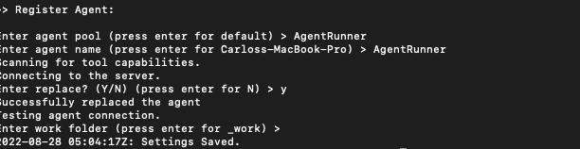
Self-Hosted Agents

Slide 14
Pipelines in Azure DevOps

Slide 15
Overview of Azure Pipelines
Platform and language independent
Interoperability with different types of repositories
Coexistence with standard of extensions available for code building
Compatibility to deploy code to different cloud vendors.
Ability to work with containerized applications
Notes:
It's platform and language independent, which means you can build code on every platform using the code base you want.
It can be integrated with different types of repositories (Azure Repos, GitHub, GitHub Enterprise, BitBucket, and so on).
Lots of extensions (standard and community-driven) are available for building your code and for handling custom tasks.
Allows you to deploy your code to different cloud vendors.
You can work with containerized applications such as Docker, Azure Container Registry, or Kubernetes.

Slide 16
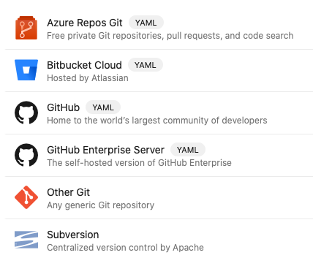
Database objects to check on DB
Scalar Objects
Lists y Colections
Data diction
Object Definition DDL
DML (Operational level)
Notes:
When we build in DevOps we need to work in IaC model therefor we need a language capable to manage or handle the infrastructure.
So we need a declarative code to manage, and that is YAML.
So what can we do with it?

Slide 17

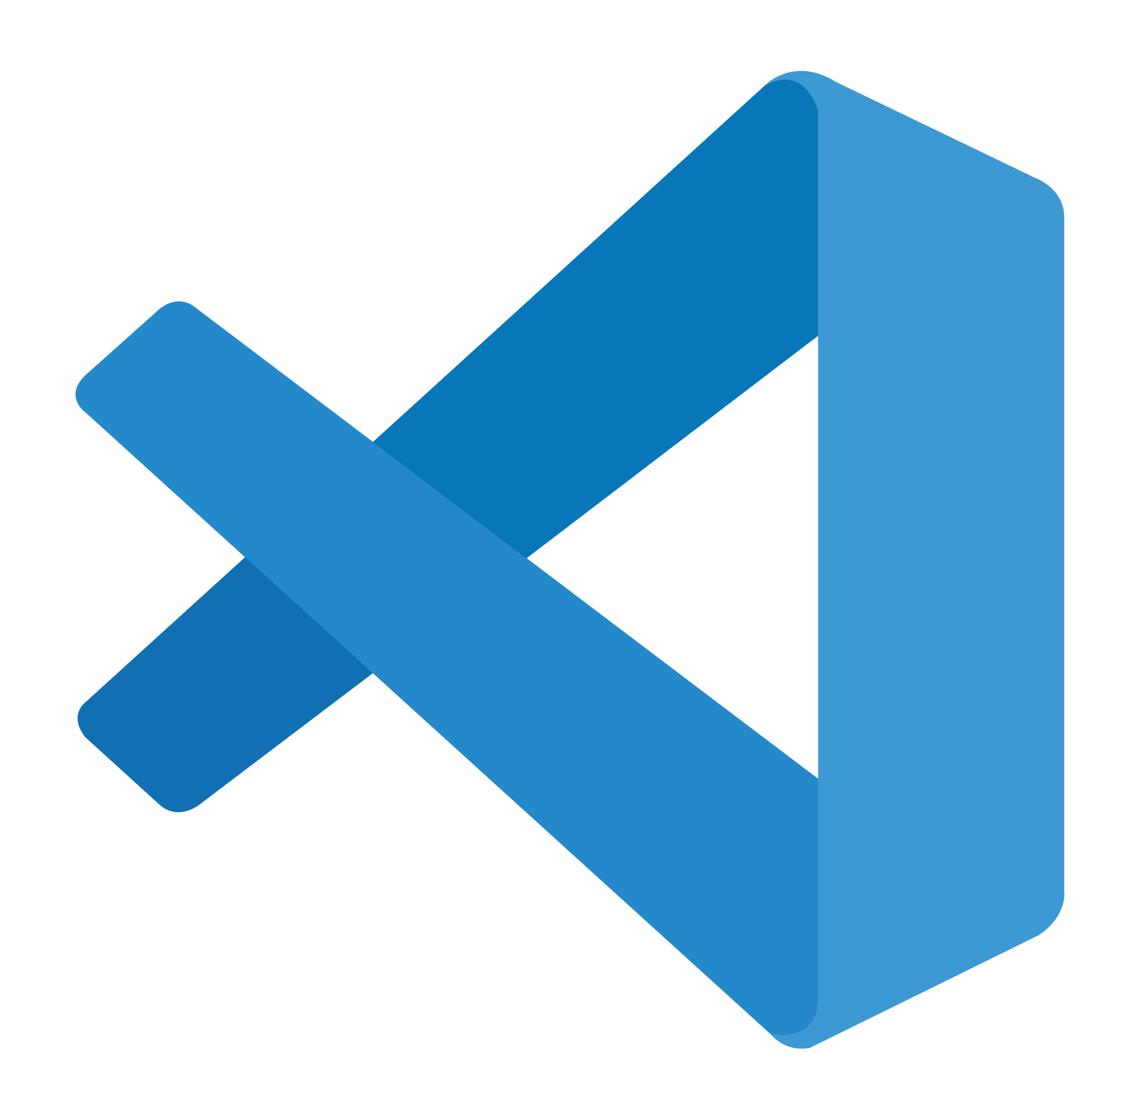

The Tools
Visual Studio Code SQL Projects in Visual Studio (SQLProj / SSDT)
Azure Data Studio Build SQLProj from command line (preview)
Alternate MSBuild SDK for SqlProj
Redgate SQL Search, SQL Prompt,

Slide 18
Best Practices
Code Control in Versioning
- Object Level History (insights tooling)
- Code analysis Rules
(naming formatting usp etc)
- Change report verification (Object by object basis)
Flyway (Community Version)
SQLFluff (open source tool)
Notes:
Migrations
where you have the complete definition and every time a new PR this has the complete control of the entire database code.
So this is what we now have to control, to actually have a solid version in the migration code.
and since we work with different teammates for the data team we must control what other say a junior sql dev might do.
Change report verification instead of looking to ALL THE CODE
Code analysis Rules – run a code analysis as part of a pipeline to catch best practices, deprecated syntax, malformed SQL structure, SELECT * or naming convention defined by the team.
Suppose you have a SQL junior dev or a new dev you need to instruct him how your team works or you need that this gets as a standardized code.

Slide 19
Database Migrations
MS EF Entity Framework
Flyway
Notes:
Now lets talk about another interesting topic that is changing our work as data professionals and it is database migrations
As we have mentioned as we need configuration items decoupled, we are changing the database from being a monolithic infrastructure and converting in to another service
So now when we talk about ORM that is object-relational mapping we are talking of a set of scripts that runs and acts to create and update the database to be deployed.
Around the same time Git got popular, the trend for writing web-based applications using object-relational mapping (ORM) libraries also became well known. The key idea was this: since developers can make changes in code that are easy to roll back using Git, why can't developers do the same thing when it comes to schema changes? After all, any reasonable new feature involves code and schema changes. So popular frameworks like Rails and Django added ORM and database migration (also known as schema migration) as part of their offerings. But database migration as a concept is not restricted to popular web frameworks. There are even standalone database migration software libraries like Flyway and Liquibase.

Slide 20
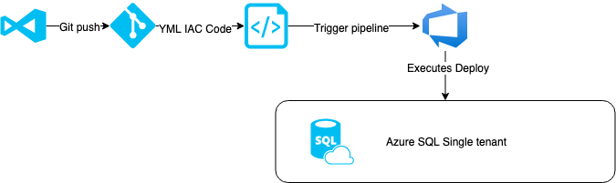
Deployment Scenario
Azure Data Studio Cross-Platform SQL Projects

Slide 21
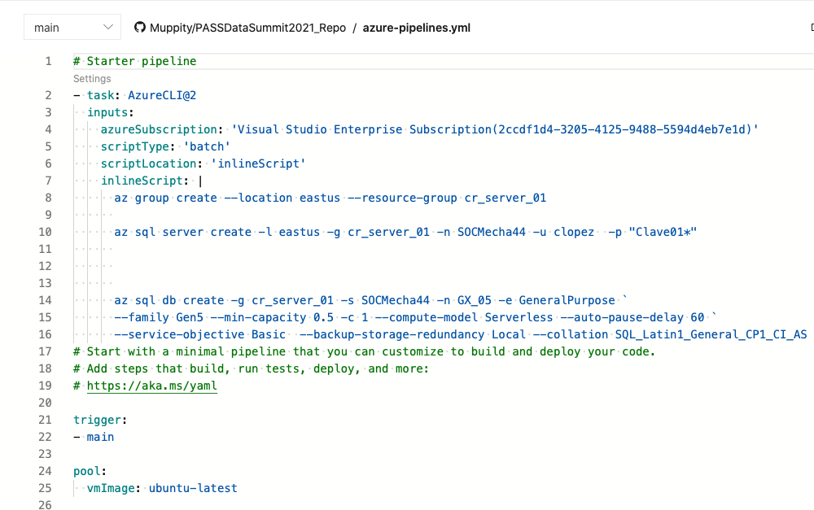
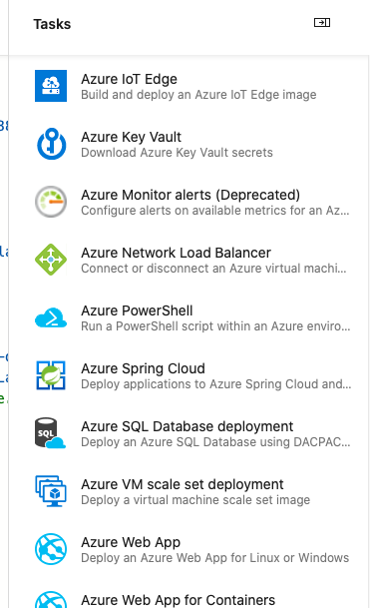
A YAML Structure

Slide 22
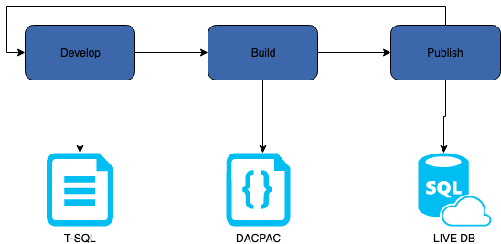
Configure Azure DB into pipeline

Slide 23
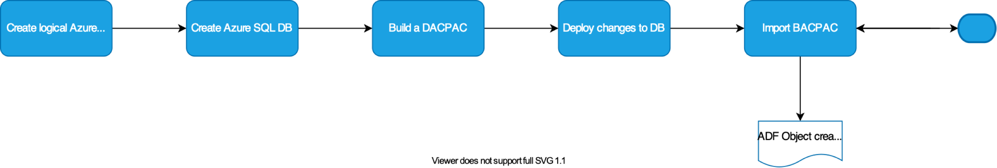
Pipeline Task Workflow
Example: Followed tasks to complete in the pipeline

Slide 24
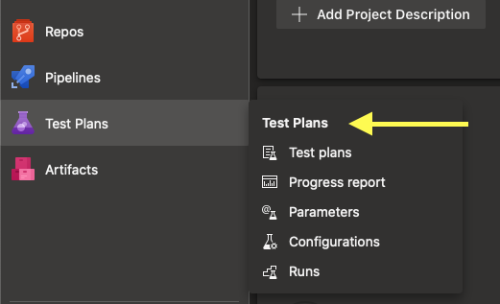
Toolset to build Quality Test
Code Analysis
SSDT Static Code Analysis examples
Samples in DACExtensions SqlServer.Rules
Standalone OSS
Sqlcheck
Code Testing
SSDT unit tests DBUnit tSQLt
SQL Code Guard

Slide 25
Additional Material
Docs Azure DevOps Azure SQL
Azure Pipelines agents Azure SQL documentation
YAML schema reference Azure SQL front page
Agent pools
Azure Devops, build GitHub repository
Blogs Learning
CI/CD for Azure SQL DB – Davide Mauri Azure SQL Ms Docs Learning Path
Code Sample Azure SQL Workshop
https://github.com/Muppity/PASSDataSummit2021_Repo

Slide 26
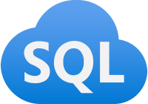
Pipeline demo Azure DevOps

Slide 27


Slide 28




Carlos Lopez
.
Github
https://github.com/Muppity/Presentations-Material
Social Networks
/carlos-lopez-taks
@CarlosLopezDBA

